Slide 1
Mechanics
Applications of Forces
Twitter: @Owen134866
www.mathsfreeresourcelibrary.com

Slide 2





Prior knowledge check
1) A particle of mass 2kg sits on a rough plane that is inclined at 45˚ to the horizontal. A force of 10N acts on the particle up the slope, parallel to the plane. Given that the particle is in limiting equilibrium, calculate the coefficient of friction, $μ$.
2) A uniform rod $AB$ of length 2m and mass 5kg rests in equilibrium at an angle of 60˚ to the horizontal. The rod is pivoted at $A$ and a force of magnitude $X N$ acts perpendicular to the rod at $B$. Find the value of $X$.
12.3N
0.278
$$X$$
$$B$$
60˚
$$A$$

Slide 3
Teachings for Exercise 7A

Slide 4
Applications of Forces
You need to be able to solve problems involving static particles
A particle is in static equilibrium if it is at rest and the resultant forces acting on it are equal to 0.
This is in contrast to dynamics, where are particle is being caused to move in some way by combinations of forces…
7A

Slide 5






Applications of Forces
y
You need to be able to solve problems involving static particles
You should:
Draw a diagram and label the forces
Resolve into horizontal/vertical or parallel/perpendicular components
Set the sums equal to 0 (as the objects are in equilibrium, the forces acting in opposite directions must cancel out…
Solve the equations to find the unknown forces…
The particle to the left is in equilibrium. Calculate the magnitude of the forces P and Q.
→ This means the horizontal and vertical forces cancel out (acceleration = 0 in both directions so F = 0)
4N
P N
4Sin45
PSin30
45°
30°
x
4Cos45
PCos30
Q N
Resolve Horizontally
$$R(→)$$
$$F=ma$$
Choose a direction as positive and sub in values
$$PCos30−4Cos45=0$$
Rearrange
$$PCos30=4cos45$$
Divide by Cos30
$$P=\frac{4cos45 }{Cos30}$$
Calculate
$$P=3.27N$$
7A

Slide 6




Applications of Forces
y
You need to be able to solve problems involving static particles
You should:
Draw a diagram and label the forces
Resolve into horizontal/vertical or parallel/perpendicular components
Set the sums equal to 0 (as the objects are in equilibrium, the forces acting in opposite directions must cancel out…
Solve the equations to find the unknown forces…
4N
The particle to the left is in equilibrium. Calculate the magnitude of the forces P and Q.
→ This means the horizontal and vertical forces cancel out (acceleration = 0 in both directions so F = 0)
P N
4Sin45
PSin30
45°
30°
x
4Cos45
PCos30
Q N
P = 3.27N
Resolve Vertically
$$R(↑)$$
$$F=ma$$
Choose a direction as positive and sub in values
$$Psin30+4Sin45−Q=0$$
Add Q
$$Psin30+4Sin45=Q$$
Calculate Q using the exact value of P from the first part
$$4.46=Q$$
You will usually need to identify which direction is solvable first, then solve the second direction after!
7A

Slide 7








Applications of Forces
y
You need to be able to solve problems involving static particles
The diagram to the right shows a particle in equilibrium under a number of forces.
Calculate the magnitudes of the forces P and Q
→ Start by resolving in both directions
Q N
P N
1N
QSin55
PSin40
55°
40°
x
QCos55
PCos40
2N
Resolve Horizontally
$$R(→)$$
1)
$$PCos40−QCos55=0$$
$$F=ma$$
Choose a direction as positive and sub in values
2)
$$PSin40+QSin55−1=0$$
$$PCos40−QCos55=0$$
Resolve Vertically
$$R(↑)$$
$$F=ma$$
Choose a direction as positive and sub in values
$$PSin40+QSin55+1−2=0$$
$$PSin40+QSin55−1=0$$
Simplify
7A

Slide 8






Applications of Forces
y
You need to be able to solve problems involving static particles
The diagram to the right shows a particle in equilibrium under a number of forces.
Calculate the magnitudes of the forces P and Q
→ Start by resolving in both directions
You can now solve these by rearranging one and subbing it into the other!
Q = 0.769N
Q N
P N
1N
QSin55
PSin40
55°
40°
x
QCos55
PCos40
2N
2)
$$PSin40+QSin55−1=0$$
Replace P with the Q equivalent
$$P=\frac{QCos55}{Cos40}$$
$$\left(\frac{QCos55}{Cos40}\right)Sin40+QSin55−1=0$$
1)
$$PCos40−QCos55=0$$
Multiply all terms by Cos40
2)
$$PSin40+QSin55−1=0$$
$$QCos55Sin40+QSin55Cos40−Cos40=0$$
Add Cos40
$$QCos55Sin40+QSin55Cos40=Cos40$$
Factorise Q on the left side
Divide by the bracket
$$Q(Cos55Sin40+Sin55Cos40)=Cos40$$
$$Q=\frac{Cos40}{(Cos55Sin40+Sin55Cos40)}$$
Calculate
$$Q=0.769N$$
7A

Slide 9



Applications of Forces
y
You need to be able to solve problems involving static particles
The diagram to the right shows a particle in equilibrium under a number of forces.
Calculate the magnitudes of the forces P and Q
→ Start by resolving in both directions
You can now solve these by rearranging one and subbing it into the other!
Q = 0.769N
P = 0.576N
Q N
P N
1N
QSin55
PSin40
55°
40°
x
QCos55
PCos40
2N
1)
$$P=\frac{QCos55}{Cos40}$$
1)
$$PCos40−QCos55=0$$
$$P=\frac{QCos55}{Cos40}$$
Sub in Q (use the exact value)
2)
$$PSin40+QSin55−1=0$$
$$P=\frac{0.769Cos55}{Cos40}$$
Calculate
$$P=0.576N$$
7A

Slide 10








Applications of Forces
PN
You need to be able to solve problems involving static particles
The diagram shows a particle in equilibrium on an inclined plane under the effect of the forces shown.
Find the size of angle θ and the value of force P.
→ Start by splitting forces into parallel and perpendicular directions
2N
PSinθ
θ
PCosθ
5Cos30
30°
5N
30°
5Sin30
8N
Resolving Parallel
$$R(↗)$$
$$F=ma$$
Use P as the positive direction and sub in values
$$PCosθ−5Sin30−8=0$$
1)
$$PCosθ=5Sin30+8$$
Rearrange to leave PCosθ
$$PCosθ=5Sin30+8$$
2)
$$PSinθ=5Cos30−2$$
Resolving Perpendicular
$$R(↖)$$
$$F=ma$$
Use P as the positive direction and sub in values
$$PSinθ+2−5Cos30=0$$
Rearrange to leave PSinθ
$$PSinθ=5Cos30−2$$
7A

Slide 11






Applications of Forces
PN
You need to be able to solve problems involving static particles
The diagram shows a particle in equilibrium on an inclined plane under the effect of the forces shown.
Find the size of angle θ and the value of force P.
→ Start by splitting forces into parallel and perpendicular directions
2N
PSinθ
θ
PCosθ
5Cos30
30°
5N
30°
5Sin30
8N
2)
$$PSinθ=5Cos30−2$$
1)
$$PCosθ=5Sin30+8$$
Divide equation 2 by equation 1
Each side must be divided as a whole, not individual parts
P’s cancel, Sin/Cos = Tan
1)
$$PCosθ=5Sin30+8$$
$$Tanθ=$$
$$\frac{5Cos30−2}{5Sin30+8}$$
2)
$$PSinθ=5Cos30−2$$
Work out the fraction
$$Tanθ=0.2219…$$
$$θ=12.5°$$
$$θ=12.5°$$
Use inverse Tan
7A

Slide 12





Applications of Forces
PN
You need to be able to solve problems involving static particles
The diagram shows a particle in equilibrium on an inclined plane under the effect of the forces shown.
Find the size of angle θ and the value of force P.
→ Start by splitting forces into parallel and perpendicular directions
2N
PSinθ
θ
PCosθ
5Cos30
30°
5N
30°
5Sin30
8N
1)
$$PCosθ=5Sin30+8$$
Divide by Cosθ
$$P=\frac{5Sin30+8 }{Cosθ}$$
1)
$$PCosθ=5Sin30+8$$
Sub in the exact value for θ
2)
$$PSinθ=5Cos30−2$$
$$P=\frac{5Sin30+8 }{Cos12.5}$$
$$θ=12.5°$$
Calculate P
$$P=10.8N$$
$$P=10.8N$$
7A

Slide 13
Teachings for Exercise 7B

Slide 14






Applications of Forces
X
Z
Draw a diagram
You need to know when to include additional forces on your diagrams, such as weight, tension, thrust, the normal reaction and friction
A smooth bead, Y, is threaded on a light inextensible string. The ends of the string are attached to two fixed points X and Z on the same horizontal level. The bead is held in equilibrium by a horizontal force of 8N acting in the direction ZX. Bead Y hangs vertically below X and angle XZY = 30°.
Find:
The tension in the string
The weight of the bead
30°
T
T
Since this is only one string and it is inextensible, the tension in it will be the same
Call the mass m, since we do not know it…
TSin30
Y
30°
8
TCos30
mg
Resolve Horizontally
$$R(→)$$
$$F=ma$$
Sub in values, choosing T as the positive direction
$$TCos30−8=0$$
$$T=9.24N$$
Add 8
$$TCos30=8$$
$$T=\frac{8}{Cos30}$$
Divide by Cos30
Calculate
$$T=9.24N$$
7B

Slide 15





Applications of Forces
X
Z
Draw a diagram
You need to know when to include additional forces on your diagrams, such as weight, tension, thrust, the normal reaction and friction
A smooth bead, Y, is threaded on a light inextensible string. The ends of the string are attached to two fixed points X and Z on the same horizontal level. The bead is held in equilibrium by a horizontal force of 8N acting in the direction ZX. Bead Y hangs vertically below X and angle XZY = 30°.
Find:
The tension in the string
The weight of the bead
30°
T
T
Since this is only one string and it is inextensible, the tension in it will be the same
Call the mass m, since we do not know it…
TSin30
Y
30°
8
TCos30
mg
Resolve Vertically
$$R(↑)$$
$$F=ma$$
Sub in values, choosing T as the positive direction
$$TSin30+T−mg=0$$
$$T=9.24N$$
Add mg
$$TSin30+T=mg$$
Sub in the value of T
$$9.24Sin30+9.24=mg$$
This is all we need!
$$13.86=mg$$
Be careful on this type of question. If particle is held by 2 different strings, the tensions may be different in each!
The question asked for the weight, not the mass! (weight being mass x gravity…)
7B

Slide 16





Applications of Forces
R
9.8N
T
You need to know when to include additional forces on your diagrams, such as weight, tension, thrust, the normal reaction and friction
A mass of 3kg rests on the surface of a smooth plane inclined at an angle of 45° to the horizontal. The mass is attached to a cable which passes up the plane and passes over a smooth pulley at the top. The cable carries a mass of 1kg which hangs freely at the other end. There is a force of PN acting horizontally on the 3kg mass and the system is in equilibrium.
By modelling the cable as a light inextensible string and the masses as particles, calculate:
The magnitude of P
The normal reaction between the mass and the plane
T
P
9.8N
45˚
3gCos45
PSin45
PCos45
3g
45˚
1g
45˚
3gSin45
Find the tension using the 1kg mass
$$R(↑)$$
$$F=ma$$
Resolve in the direction of T and sub in values
$$T−1g=0$$
Add 1g
$$T=1g$$
$$T=9.8N$$
7B

Slide 17







Applications of Forces
R
9.8N
You need to know when to include additional forces on your diagrams, such as weight, tension, thrust, the normal reaction and friction
A mass of 3kg rests on the surface of a smooth plane inclined at an angle of 45° to the horizontal. The mass is attached to a cable which passes up the plane and passes over a smooth pulley at the top. The cable carries a mass of 1kg which hangs freely at the other end. There is a force of PN acting horizontally on the 3kg mass and the system is in equilibrium.
By modelling the cable as a light inextensible string and the masses as particles, calculate:
The magnitude of P
The normal reaction between the mass and the plane
P
9.8N
45˚
3gCos45
PSin45
PCos45
3g
45˚
1g
45˚
3gSin45
Resolve Parallel to find P
$$R(↗)$$
$$F=ma$$
Choose P as the positive direction and sub in values
$$PCos45+9.8−3gSin45=0$$
Rearrange
$$PCos45=3gSin45−9.8$$
$$P=\frac{3gSin45−9.8 }{Cos45}$$
Divide by Cos45
Calculate
$$P=15.54N$$
$$P=15.54N$$
7B

Slide 18





Applications of Forces
R
9.8N
You need to know when to include additional forces on your diagrams, such as weight, tension, thrust, the normal reaction and friction
A mass of 3kg rests on the surface of a smooth plane inclined at an angle of 45° to the horizontal. The mass is attached to a cable which passes up the plane and passes over a smooth pulley at the top. The cable carries a mass of 1kg which hangs freely at the other end. There is a force of PN acting horizontally on the 3kg mass and the system is in equilibrium.
By modelling the cable as a light inextensible string and the masses as particles, calculate:
The magnitude of P
The normal reaction between the mass and the plane
P
9.8N
45˚
3gCos45
PSin45
PCos45
3g
45˚
1g
45˚
3gSin45
Resolve Perpendicular to find R
$$R(↖)$$
$$F=ma$$
Choose R as the positive direction and sub in values
$$R−PSin45−3gCos45=0$$
Rearrange
$$R=PSin45+3gCos45$$
Calculate
$$R=31.78N$$
Note that in this question we used the modelling assumption that the pulley is smooth (this would cause the tension to be equal either side
$$P=15.54N$$
$$R=31.78N$$
7B

Slide 19
Teachings for Exercise 7C

Slide 20



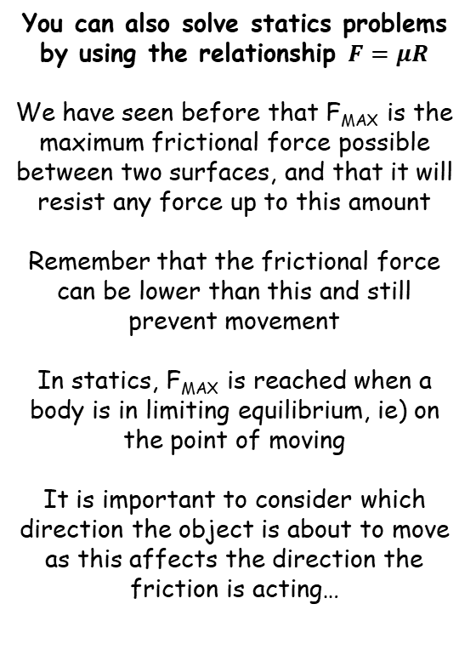




Applications of Forces
A block of mass 3kg rests on a rough horizontal plane. The coefficient of friction between the block and the plane is 0.4. When a horizontal force P N is applied to the block, the block remains in equilibrium.
Find the value for P for which the equilibrium is limiting
Find the value of F when P = 8N
You can also solve statics problems by using the relationship $F=μR$
We have seen before that F_{MAX} is the maximum frictional force possible between two surfaces, and that it will resist any force up to this amount
Remember that the frictional force can be lower than this and still prevent movement
In statics, F_{MAX} is reached when a body is in limiting equilibrium, ie) on the point of moving
It is important to consider which direction the object is about to move as this affects the direction the friction is acting…
3g
R
F
3kg
P
3g
Resolve vertically for R
$$R(↑)$$
Find F_{MAX}
$$F=ma$$
$$F_{MAX}=μR$$
Sub in values with R as positive
Sub in values
$$R−3g=0$$
$$F_{MAX}=(0.4)(3g)$$
Add 3g
Calculate
$$R=3g$$
$$F_{MAX}=11.76N$$
So if P = 11.76N, then the block is in limiting equilibrium on the point of moving
For part b), if P = 8N then equilibrium is not limiting, and P will be matched by a frictional force of 8N
7C

Slide 21


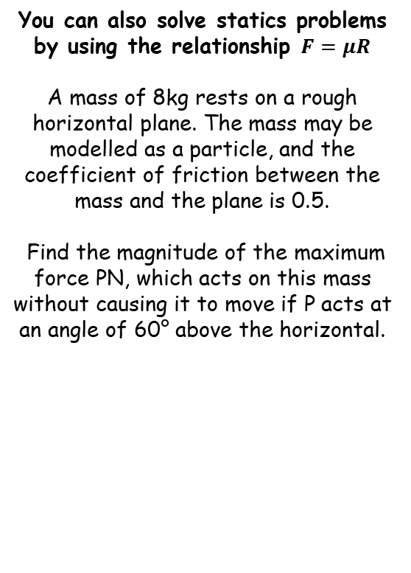



Applications of Forces
R
P
Draw a diagram
→ Find the normal reaction as we need this for F_{MAX}
You can also solve statics problems by using the relationship $F=μR$
A mass of 8kg rests on a rough horizontal plane. The mass may be modelled as a particle, and the coefficient of friction between the mass and the plane is 0.5.
Find the magnitude of the maximum force PN, which acts on this mass without causing it to move if P acts at an angle of 60° above the horizontal.
PSin60
F
60°
8kg
PCos60
8g
Resolve Vertically
$$R(↑)$$
$$F=ma$$
Sub in values with R as positive
$$R+PSin60−8g=0$$
Rearrange to find R in terms of P
$$R=8g−PSin60$$
$$F_{MAX}=4g−0.5PSin60$$
Find F_{MAX}
$$F_{MAX}=μR$$
Sub in values
$$F_{MAX}=(0.5)(8g−PSin60)$$
Multiply bracket out
$$F_{MAX}=4g−0.5PSin60$$
7C

Slide 22









Applications of Forces
R
P
Draw a diagram
→ Find the normal reaction as we need this for F_{MAX}
You can also solve statics problems by using the relationship $F=μR$
A mass of 8kg rests on a rough horizontal plane. The mass may be modelled as a particle, and the coefficient of friction between the mass and the plane is 0.5.
Find the magnitude of the maximum force PN, which acts on this mass without causing it to move if P acts at an angle of 60° above the horizontal.
PSin60
F
60°
8kg
PCos60
→ The horizontal forces will cancel out as the block is in limiting equilibrium
8g
Resolve Horizontally
$$R(→)$$
$$F=ma$$
Sub in values with P as positive
$$PCos60−F=0$$
Sub in F_{MAX}
$$PCos60−(4g−0.5PSin60)=0$$
$$F_{MAX}=4g−0.5PSin60$$
‘Multiply out’ the bracket
$$PCos60−4g+0.5PSin60=0$$
Add 4g
If $P$ is any greater, the block will start to accelerate.
If $P$ is any smaller, then F_{MAX} will be less and hence the block will not be in limiting equilibrium
$$PCos60+0.5PSin60=4g$$
Factorise P on the left side
$$P(Cos60+0.5Sin60)=4g$$
Divide by the bracket
$$P=\frac{4g }{Cos60+0.5Sin60}$$
Calculate
$$P=42.01N$$
7C

Slide 23



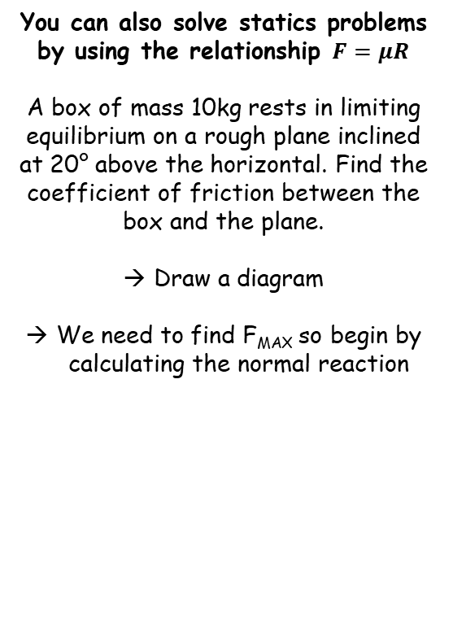





Applications of Forces
R
F
You can also solve statics problems by using the relationship $F=μR$
A box of mass 10kg rests in limiting equilibrium on a rough plane inclined at 20° above the horizontal. Find the coefficient of friction between the box and the plane.
Draw a diagram
We need to find F_{MAX} so begin by calculating the normal reaction
20$°$
10gCos20
10g
20$°$
10gSin20
Resolving Perpendicular
$$R(↖)$$
$$F=ma$$
Sub in values with R as positive
$$R−10gCos20=0$$
Rearrange
$$R=10gCos20$$
$$F_{MAX}=μ(10gCos20)$$
Finding F_{MAX}
$$F_{MAX}=μR$$
Sub in R and leave µ
$$F_{MAX}=μ(10gCos20)$$
7C

Slide 24



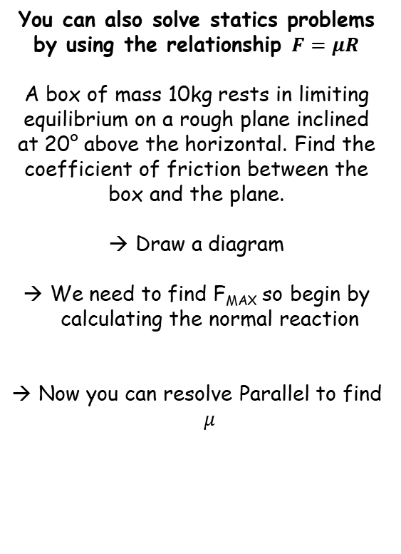



Applications of Forces
R
F
You can also solve statics problems by using the relationship $F=μR$
A box of mass 10kg rests in limiting equilibrium on a rough plane inclined at 20° above the horizontal. Find the coefficient of friction between the box and the plane.
Draw a diagram
We need to find F_{MAX} so begin by calculating the normal reaction
Now you can resolve Parallel to find $μ$
20$°$
10gCos20
10g
20$°$
10gSin20
Resolving Parallel
$$R(↗)$$
$$F=ma$$
Sub in values with ‘down the plane’ as positive
$$10gSin20−F=0$$
Sub in F_{MAX}
$$10gSin20−μ(10gCos20)=0$$
$$F_{MAX}=μ(10gCos20)$$
Add µ(10gCos20)
$$10gSin20=μ(10gCos20)$$
Divide by the bracket
$$\frac{10gSin20}{10gCos20}=μ$$
Calculate
$$0.36=μ$$
7C

Slide 25




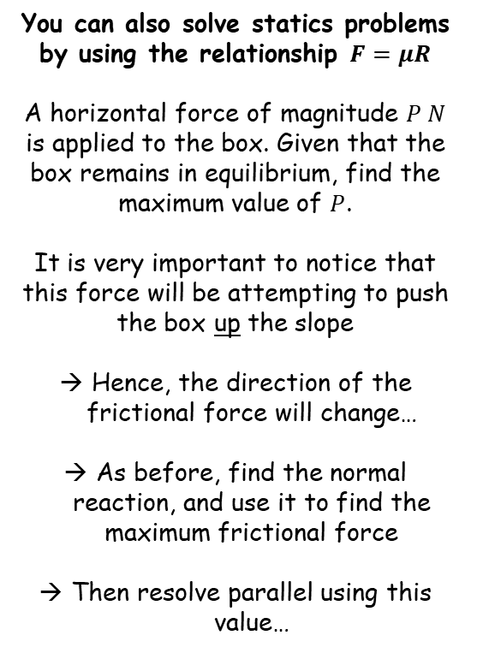





Applications of Forces
$$μ=0.36$$
R
$$\text{μ}(10gCos20+PSin20)$$
F
You can also solve statics problems by using the relationship $F=μR$
A horizontal force of magnitude $P N$ is applied to the box. Given that the box remains in equilibrium, find the maximum value of $P$.
It is very important to notice that this force will be attempting to push the box up the slope
Hence, the direction of the frictional force will change…
As before, find the normal reaction, and use it to find the maximum frictional force
Then resolve parallel using this value…
P
20˚
PCos20
20$°$
10gCos20
PSin20
10g
20$°$
10gSin20
Resolving Perpendicular
$$R(↖)$$
$$F=ma$$
Sub in values with R as positive
$$R−10gCos20−PSin20=0$$
Rearrange
$$R=10gCos20+PSin20$$
Finding F_{MAX}
$$F_{MAX}=μR$$
Sub in R (we can leave $μ$ as it is for now to avoid rounding errors…)
$$F_{MAX}=μ(10gCos20+PSin20)$$
Now update the diagram with this information…
7C

Slide 26


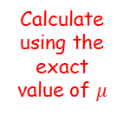

Applications of Forces
$$μ=0.36$$
R
$$\text{μ}(10gCos20+PSin20)$$
You can also solve statics problems by using the relationship $F=μR$
A horizontal force of magnitude $P N$ is applied to the box. Given that the box remains in equilibrium, find the maximum value of $P$.
It is very important to notice that this force will be attempting to push the box up the slope
Hence, the direction of the frictional force will change…
As before, find the normal reaction, and use it to find the maximum frictional force
Then resolve parallel using this value…
P
20˚
PCos20
20$°$
10gCos20
PSin20
10g
20$°$
10gSin20
Resolving Parallel
$$R(↗)$$
$$F=ma$$
Sub in values with ‘up the plane’ as positive
$$PCos20−10gSin20−μ(10gCos20+PSin20)=0$$
Expand bracket
$$PCos20−10gSin20−10gμCos20−PμSin20=0$$
Rearrange
$$PCos20−PμSin20=10gSin20+10gμCos20$$
Factorise left side
$$P(Cos20−μSin20)=10gSin20+10gμCos20$$
Divide by bracket
$$P=\frac{10gSin20+10gμCos20}{Cos20−μSin20}$$
Calculate using the exact value of $μ$
$$P=82N (2sf)$$
7C

Slide 27
Teachings for Exercise 7D

Slide 28









Applications of Forces
N
B
2m
You can solve problems about rigid bodies resting in limiting equilibrium
If a body is on the point of moving it is said to be in limiting equilibrium. In this case, the frictional force takes its maximum value, µR, where µ is the coefficient of friction and R is the normal reaction.
A uniform rod AB of mass 40kg and length 10m rests with the end A on rough horizontal ground. The rod rests against a smooth peg C where AC = 8m. The rod is in limiting equilibrium at an angle of 15° to the horizontal. Find:
The magnitude of the reaction at C
The coefficient of friction between the rod and the ground
(2)
3m
R
(1)
5m
40gCos15
40g
15°
15°
40gSin15
A
F
Draw a diagram and label all the forces: Weight, the normal reactions and friction. Split into components if needed
The rod will have a tendency to slide downwards, with the base moving to the left. Hence, friction will oppose this
Taking moments about A will mean we can find the normal reaction at the peg.
Taking moments about A
(1)
$$40gCos15×5$$
$$=200gCos15 Nm clockwise$$
(2)
$$N×8$$
$$= 8N Nm anticlockwise$$
40gSin15 is NOT included as a moment about A. This is because it actually acts down the rod and through point A (as opposed to the place where it has been drawn), therefore it has a perpendicular distance of 0 and hence can be ignored…
$$200gCos15=8N$$
Divide by 8
$$N=237N$$
$$25gCos15=N$$
Calculate
$$237=N$$
7D

Slide 29






Applications of Forces
237Sin15
237Cos15
B
You can solve problems about rigid bodies resting in limiting equilibrium
If a body is on the point of moving it is said to be in limiting equilibrium. In this case, the frictional force takes its maximum value, µR, where µ is the coefficient of friction and R is the normal reaction.
A uniform rod AB of mass 40kg and length 10m rests with the end A on rough horizontal ground. The rod rests against a smooth peg C where AC = 8m. The rod is in limiting equilibrium at an angle of 15° to the horizontal. Find:
The magnitude of the reaction at C
The coefficient of friction between the rod and the ground
237
15°
R
40g
40gCos15
15°
15°
40gSin15
A
F
Now you can resolve horizontally and vertically to find the remaining forces
You will need to split the normal reaction at the peg into horizontal and vertical components
The parallel and perpendicular components of the weight will no longer be needed…
Resolving Horizontally
$$R(→)$$
$$F=237Sin15$$
Resolving Vertically
$$R(↑)$$
$$N=237N$$
$$R+237Cos15=40g$$
Rearrange
$$R=40g−237Cos15$$
$$F=237Sin15$$
$$R=40g−237Cos15$$
7D

Slide 30



Applications of Forces
237Sin15
237Cos15
B
You can solve problems about rigid bodies resting in limiting equilibrium
If a body is on the point of moving it is said to be in limiting equilibrium. In this case, the frictional force takes its maximum value, µR, where µ is the coefficient of friction and R is the normal reaction.
A uniform rod AB of mass 40kg and length 10m rests with the end A on rough horizontal ground. The rod rests against a smooth peg C where AC = 8m. The rod is in limiting equilibrium at an angle of 15° to the horizontal. Find:
The magnitude of the reaction at C
The coefficient of friction between the rod and the ground
237
15°
R
40g
15°
A
F
As the rod is in limiting equilibrium, friction is at its maximum value
Use the formula for F_{MAX} and sub in the values we have calculated
$$F_{MAX}=μR$$
Sub in values
$$237Sin15=μ(40g−237Cos15)$$
Divide by the bracket
$$\frac{237Sin15}{40g−237Cos15}=μ$$
Calculate
$$N=237N$$
$$0.37=μ$$
$$F=237Sin15$$
$$R=40g−237Cos15$$
7D

Slide 31










Applications of Forces
R_{W}Sin60
You can solve problems about rigid bodies resting in limiting equilibrium
A ladder, AB, of mass m and length 3a, has one end A resting on rough horizontal ground. The other end, B, rests against a smooth vertical wall. A load of mass 2m is fixed on the ladder at point C, where AC = a. The ladder is modelled as a uniform rod and the load is modelled as a particle. The ladder rests in limiting equilibrium at an angle of 60° with the ground.
Find the coefficient of friction between the ladder and the ground.
R_{W}
60°
B
(3)
1.5a
Start with a diagram and label all forces – both masses should be split into parallel and perpendicular components
(2)
(1)
0.5a
mgCos60
R_{G}
C
60°
We will now take moments about point A to give us the value of R_{W}
a
2mgCos60
60°
60°
A
F
2mg
mg
(1)
$$2mgCos60×a$$
$$= 2amgCos60 Nm clockwise$$
(2)
$$mgCos60×1.5a$$
$$= 1.5amgCos60 Nm clockwise$$
(3)
$$R_{W}Sin60×3a$$
$$= 3aR_{W}Sin60 Nm anticlockwise$$
$$R_{W}=\frac{3.5mgCos60 }{3Sin60}$$
$$3aR_{W}Sin60=2amgCos60+1.5amgCos60$$
Cancel a’s
Calculate in terms of mg
$$3R_{W}Sin60=2mgCos60+1.5mgCos60$$
$$R_{W}=\frac{7mg\sqrt{3} }{18}$$
Group terms
$$3R_{W}Sin60=3.5mgCos60$$
$$R_{W}=\frac{3.5mgCos60 }{3Sin60}$$
Divide by 3Sin60
7D

Slide 32





Applications of Forces
R_{W}Sin60
You can solve problems about rigid bodies resting in limiting equilibrium
A ladder, AB, of mass m and length 3a, has one end A resting on rough horizontal ground. The other end, B, rests against a smooth vertical wall. A load of mass 2m is fixed on the ladder at point C, where AC = a. The ladder is modelled as a uniform rod and the load is modelled as a particle. The ladder rests in limiting equilibrium at an angle of 60° with the ground.
Find the coefficient of friction between the ladder and the ground.
R_{W}
60°
B
(3)
1.5a
Now we can resolve horizontally and vertically
→ This will allow us to find expressions for R_{G} and F, and hence, the coefficient of friction
(2)
(1)
0.5a
mgCos60
R_{G}
C
60°
a
2mgCos60
60°
60°
A
F
2mg
mg
Resolving Horizontally
$$R(→)$$
$$F=R_{W}$$
We already know R_{W} so therefore also know F!
$$F=\frac{7mg\sqrt{3} }{18}$$
$$R_{W}=\frac{7mg\sqrt{3} }{18}$$
$$F=\frac{7mg\sqrt{3} }{18}$$
7D

Slide 33




Applications of Forces
R_{W}Sin60
You can solve problems about rigid bodies resting in limiting equilibrium
A ladder, AB, of mass m and length 3a, has one end A resting on rough horizontal ground. The other end, B, rests against a smooth vertical wall. A load of mass 2m is fixed on the ladder at point C, where AC = a. The ladder is modelled as a uniform rod and the load is modelled as a particle. The ladder rests in limiting equilibrium at an angle of 60° with the ground.
Find the coefficient of friction between the ladder and the ground.
R_{W}
60°
B
(3)
1.5a
Now we can resolve horizontally and vertically
→ This will allow us to find expressions for R_{G} and F, and hence, the coefficient of friction
(2)
(1)
0.5a
mgCos60
R_{G}
C
60°
a
2mgCos60
60°
60°
A
F
2mg
mg
Resolving Vertically
$$R(↑)$$
$$R_{G}=2mg+mg$$
Simplify
$$R_{G}=3mg$$
$$R_{W}=\frac{7mg\sqrt{3} }{18}$$
$$F=\frac{7mg\sqrt{3} }{18}$$
$$R_{G}=3mg$$
7D

Slide 34





Applications of Forces
R_{W}Sin60
You can solve problems about rigid bodies resting in limiting equilibrium
A ladder, AB, of mass m and length 3a, has one end A resting on rough horizontal ground. The other end, B, rests against a smooth vertical wall. A load of mass 2m is fixed on the ladder at point C, where AC = a. The ladder is modelled as a uniform rod and the load is modelled as a particle. The ladder rests in limiting equilibrium at an angle of 60° with the ground.
Find the coefficient of friction between the ladder and the ground.
R_{W}
60°
B
(3)
1.5a
(2)
As the ladder is in limiting equilibrium, we can use the formula for friction
(1)
0.5a
mgCos60
R_{G}
C
60°
a
2mgCos60
60°
60°
A
F
2mg
mg
$$FMAX=μR$$
Sub in values
$$\frac{7mg\sqrt{3} }{18}=3mgμ$$
Cancel mg’s
$$\frac{7\sqrt{3} }{18}=3μ$$
$$R_{W}=\frac{7mg\sqrt{3} }{18}$$
$$F=\frac{7mg\sqrt{3} }{18}$$
$$\frac{7\sqrt{3} }{54}=μ$$
Divide by 3
$$R_{G}=3mg$$
Calculate
$$0.22=μ$$
7D

Slide 35
Teachings for Exercise 7E

Slide 36





Applications of Forces
R
0.8mg
F
You need to be able to solve problems involving dynamics on an inclined plane
A particle is held at rest on a rough plane inclined at an angle of θ to the horizontal, where Tanθ is 0.75. If the coefficient of friction between the particle and the plane is 0.5, find the acceleration of the particle.
You can find the below values (based on tanθ = 0.75) by drawing a right angled triangle and finding the hypotenuse (as in section 3D)
Tanθ = ³/₄
Sinθ = ³/₅ (0.6)
Cosθ = ⁴/₅ (0.8)
a
mkg
mgCosθ
θ
0.8mg
mg
θ
mgSinθ
We need the normal reaction in order to find the maximum frictional force
→ Resolve perpendicular to the plane
$$R(↖)$$
$$F=ma$$
Resolve perpendicular to the plane
$$R−mgCosθ=(m×0)$$
We have to use ‘m’ for now as we do not know the mass…
$$R=mgCosθ$$
We know the value of Cosθ
$$R=0.8mg$$
7E

Slide 37



Applications of Forces
0.8mg
0.4mg
F
You need to be able to solve problems involving dynamics on an inclined plane
A particle is held at rest on a rough plane inclined at an angle of θ to the horizontal, where Tanθ is 0.75. If the coefficient of friction between the particle and the plane is 0.5, find the acceleration of the particle.
You can find the below values (based on tanθ = 0.75) by drawing a right angled triangle and finding the hypotenuse (as in section 3D)
Tanθ = ³/₄
Sinθ = ³/₅ (0.6)
Cosθ = ⁴/₅ (0.8)
a
mkg
θ
0.8mg
mg
θ
mgSinθ
$$F_{MAX}=μR$$
$$F_{MAX}=(0.5×0.8mg)$$
Sub in values
$$F_{MAX}=0.4mg$$
Calculate
7E

Slide 38





Applications of Forces
0.8mg
0.4mg
You need to be able to solve problems involving dynamics on an inclined plane
A particle is held at rest on a rough plane inclined at an angle of θ to the horizontal, where Tanθ is 0.75. If the coefficient of friction between the particle and the plane is 0.5, find the acceleration of the particle.
You can find the below values (based on tanθ = 0.75) by drawing a right angled triangle and finding the hypotenuse (as in section 3D)
Tanθ = ³/₄
Sinθ = ³/₅ (0.6)
Cosθ = ⁴/₅ (0.8)
a
mkg
θ
0.8mg
mg
θ
mgSinθ
Now we have all the forces involved acting in the required directions, we can now calculate the acceleration of the particle…
→ Resolve parallel to the plane
$$R(↗)$$
$$F=ma$$
Sub in values and resolve parallel
$$mgSinθ−0.4mg=ma$$
The m’s cancel (meaning the mass does not affect the acceleration!)
$$gSinθ−0.4g=a$$
$$(9.8×0.6)−(0.4×9.8)=a$$
Calculate a (remember, we know Sinθ)
$$2.0ms^{−2}=a (2sf)$$
7E

Slide 39




Applications of Forces
43N
2.5ms⁻²
R
F
You need to be able to solve problems involving dynamics on an inclined plane
A mass of 4kg is pushed up a plane by a horizontal force of magnitude 25N. The plane is inclined to the horizontal at 10° and the particle accelerates at 2.5ms⁻². Calculate the coefficient of friction between the box and the plane.
In this type of question you should proceed as if you did have the coefficient of friction. You will end up with an equation where you can solve for µ.
25N
4kg
10°
25Sin10
25Cos10
4gCos10
4g
10°
10°
4gSin10
We need to split the forces into parallel and perpendicular components…
Now we can resolve perpendicular to find the normal reaction, and hence, the maximum frictional resistance created
Resolve perpendicular to the plane…
$$R(↖)$$
$$F=ma$$
Sub in values and resolve perpendicular
$$R−25Sin10−4gCos10=(4×0)$$
Rearrange
$$R=25Sin10+4gCos10$$
Calculate
$$R=43N (2sf)$$
7E

Slide 40


Applications of Forces
43N
2.5ms⁻²
43µ
F
You need to be able to solve problems involving dynamics on an inclined plane
A mass of 4kg is pushed up a plane by a horizontal force of magnitude 25N. The plane is inclined to the horizontal at 10° and the particle accelerates at 2.5ms⁻². Calculate the coefficient of friction between the box and the plane.
In this type of question you should proceed as if you did have the coefficient of friction. You will end up with an equation where you can solve for µ.
25N
4kg
10°
25Sin10
25Cos10
4gCos10
4g
10°
10°
4gSin10
Now we can find the maximum frictional force created between the surfaces…
$$F_{MAX}=μR$$
Sub in values (remember to use exact values, not rounded ones)
$$F_{MAX}=\left(μ×43\right)$$
Leave in terms of µ
$$F_{MAX}=43μ$$
7E

Slide 41






Applications of Forces
43N
2.5ms⁻²
43µ
You need to be able to solve problems involving dynamics on an inclined plane
A mass of 4kg is pushed up a plane by a horizontal force of magnitude 25N. The plane is inclined to the horizontal at 10° and the particle accelerates at 2.5ms⁻². Calculate the coefficient of friction between the box and the plane.
In this type of question you should proceed as if you did have the coefficient of friction. You will end up with an equation where you can solve for µ.
25N
4kg
10°
25Sin10
25Cos10
4gCos10
4g
10°
10°
4gSin10
Now we have all the forces acting perpendicular to the plane, we can find the value of µ
Resolve parallel to the plane…
$$R(↗)$$
$$F=ma$$
Sub in values and resolve parallel
$$25Cos10−43μ−4gSin10=(4×2.5)$$
Rearrange to find µ
$$25Cos10−4gSin10−(4×2.5)=43μ$$
Solve exactly
$$7.8131…=43μ$$
Remember to use exact values!!
$$0.18=μ$$
7E

Slide 42
Teachings for Exercise 7F

Slide 43




Applications of Forces
5gCos25
a
R
T
Draw a diagram
→ Remember to split the forces into parallel and perpendicular (where appropriate!)
You can solve problems involving connected particles on rough and smooth inclined surfaces
Two particles, P and Q, of masses 5kg and 10kg are connected by a light inextensible string. The string passes over a small smooth pulley which is fixed at the top of a plane inclined at an angle of 25° to the horizontal. P is resting on the plane and Q hangs freely with the string vertical and taut. The coefficient of friction between P and the plane is 0.2.
Find the acceleration of the system
Find the tension in the string
P
F
T
5gCos25
25˚
5g
Q
a
25˚
5gSin25
10g
We will need to form 2 equations, one for each particle
For particle P, we need to calculate the frictional force first
Resolve perpendicular to find the normal reaction
$$R(↖)$$
$$F=ma$$
Resolve perpendicular for P
$$R−5gCos25=(5×0)$$
Rearrange
$$R=5gCos25$$
7F

Slide 44



Applications of Forces
5gCos25
a
T
Draw a diagram
→ Remember to split the forces into parallel and perpendicular (where appropriate!)
You can solve problems involving connected particles on rough and smooth inclined surfaces
Two particles, P and Q, of masses 5kg and 10kg are connected by a light inextensible string. The string passes over a small smooth pulley which is fixed at the top of a plane inclined at an angle of 25° to the horizontal. P is resting on the plane and Q hangs freely with the string vertical and taut. The coefficient of friction between P and the plane is 0.2.
Find the acceleration of the system
Find the tension in the string
P
F
T
gCos25
5gCos25
25˚
5g
Q
a
25˚
5gSin25
10g
$$F_{MAX}=μR$$
Sub in values for particle P
$$F_{MAX}=(0.2×5gCos25)$$
Calculate
$$F_{MAX}=gCos25$$
7F

Slide 45








Applications of Forces
5gCos25
a
T
Draw a diagram
→ Remember to split the forces into parallel and perpendicular (where appropriate!)
You can solve problems involving connected particles on rough and smooth inclined surfaces
Two particles, P and Q, of masses 5kg and 10kg are connected by a light inextensible string. The string passes over a small smooth pulley which is fixed at the top of a plane inclined at an angle of 25° to the horizontal. P is resting on the plane and Q hangs freely with the string vertical and taut. The coefficient of friction between P and the plane is 0.2.
Find the acceleration of the system
Find the tension in the string
P
gCos25
T
5gCos25
25˚
5g
Q
a
25˚
5gSin25
10g
Now we can form 2 equations using P and Q
Equation for P
→ Resolve Parallel
Equation for Q
→ Resolve Vertically
$$R(↗)$$
$$R(↓)$$
$$F=ma$$
Resolve Parallel for P
$$F=ma$$
Resolve Vertically for Q
$$T−gCos25−5gSin25=5a$$
$$10g−T=10a$$
$$T−gCos25−5gSin25=5a$$
Add the equations together
→ The T’s cancel out!
$$10g−T=10a$$
$$10g−gCos25−5gSin25=15a$$
Solve for a
$$4.56=a$$
7F

Slide 46



Applications of Forces
5gCos25
a
T
Draw a diagram
→ Remember to split the forces into parallel and perpendicular (where appropriate!)
You can solve problems involving connected particles on rough and smooth inclined surfaces
Two particles, P and Q, of masses 5kg and 10kg are connected by a light inextensible string. The string passes over a small smooth pulley which is fixed at the top of a plane inclined at an angle of 25° to the horizontal. P is resting on the plane and Q hangs freely with the string vertical and taut. The coefficient of friction between P and the plane is 0.2.
Find the acceleration of the system
Find the tension in the string
P
gCos25
T
5gCos25
25˚
5g
Q
a
25˚
5gSin25
10g
Use one of the previous equations to find the tension
$$10g−T=10a$$
We now know the acceleration
$$10g−T=10(4.56)$$
Solve for T
4.56ms⁻²
$$T=52.4N$$
7F

Slide 47

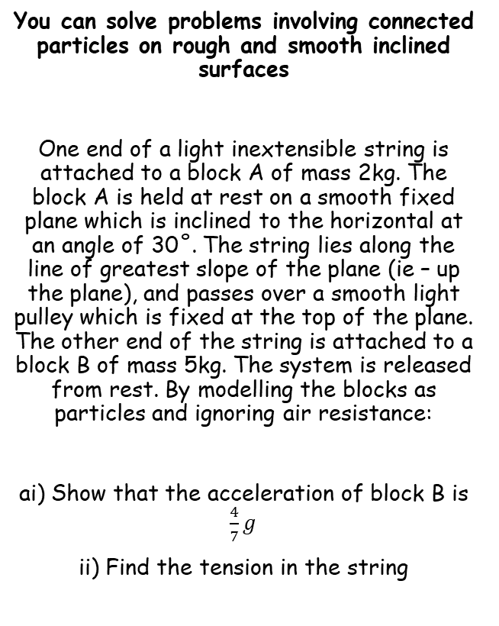






Applications of Forces
R
a
T
Draw a diagram
→ Remember to split the forces on the blocks into parallel and perpendicular (where appropriate!)
You can solve problems involving connected particles on rough and smooth inclined surfaces
One end of a light inextensible string is attached to a block A of mass 2kg. The block A is held at rest on a smooth fixed plane which is inclined to the horizontal at an angle of 30˚. The string lies along the line of greatest slope of the plane (ie – up the plane), and passes over a smooth light pulley which is fixed at the top of the plane. The other end of the string is attached to a block B of mass 5kg. The system is released from rest. By modelling the blocks as particles and ignoring air resistance:
ai) Show that the acceleration of block B is $\frac{4}{7}g$
ii) Find the tension in the string
A
T
30˚
2gCos30
2g
B
a
30˚
2gSin30
5g
Note that as the plane is smooth, there will be no frictional force. Hence, we also do not need the normal reaction…
→ Form equations for each block separately
Block A
$$R(↗)$$
Block B
$$R(↓)$$
$$F=ma$$
$$F=ma$$
Sub in values
Sub in values
$$T−2gSin30=2a$$
$$5g−T=5a$$
Sin30 = 0.5
$$T−g=2a$$
7F

Slide 48





Applications of Forces
R
a
T
Draw a diagram
→ Remember to split the forces on the blocks into parallel and perpendicular (where appropriate!)
You can solve problems involving connected particles on rough and smooth inclined surfaces
One end of a light inextensible string is attached to a block A of mass 2kg. The block A is held at rest on a smooth fixed plane which is inclined to the horizontal at an angle of 30˚. The string lies along the line of greatest slope of the plane (ie – up the plane), and passes over a smooth light pulley which is fixed at the top of the plane. The other end of the string is attached to a block B of mass 5kg. The system is released from rest. By modelling the blocks as particles and ignoring air resistance:
ai) Show that the acceleration of block B is $\frac{4}{7}g$
ii) Find the tension in the string
A
T
30˚
2gCos30
2g
B
a
30˚
2gSin30
5g
1)
$$T−g=2a$$
2)
$$5g−T=5a$$
→ Add the equations together
$$4g=7a$$
$$\frac{4}{7}g=a$$
Divide by 7
Sub this value in either 1) or 2) to get the tension…
$$\frac{15}{7}g=T$$
7F

Slide 49


Applications of Forces
R
a
T
Draw a diagram
→ Remember to split the forces on the blocks into parallel and perpendicular (where appropriate!)
You can solve problems involving connected particles on rough and smooth inclined surfaces
One end of a light inextensible string is attached to a block A of mass 2kg. The block A is held at rest on a smooth fixed plane which is inclined to the horizontal at an angle of 30˚. The string lies along the line of greatest slope of the plane (ie – up the plane), and passes over a smooth light pulley which is fixed at the top of the plane. The other end of the string is attached to a block B of mass 5kg. The system is released from rest. By modelling the blocks as particles and ignoring air resistance:
b) State how you have used the fact that the string is inextensible in your calculations
A
T
30˚
2gCos30
2g
B
a
30˚
2gSin30
5g
If the string is inextensible, it cannot stretch. Hence, the acceleration of both particles is the same
(you must remember to refer to your calculations, rather than just saying ‘the string doesn’t stretch…)
$$a=\frac{4}{7}g$$
$$T=\frac{15}{7}g$$
7F

Slide 50





Applications of Forces
R
a
T
Draw a diagram
→ Remember to split the forces on the blocks into parallel and perpendicular (where appropriate!)
You can solve problems involving connected particles on rough and smooth inclined surfaces
One end of a light inextensible string is attached to a block A of mass 2kg. The block A is held at rest on a smooth fixed plane which is inclined to the horizontal at an angle of 30˚. The string lies along the line of greatest slope of the plane (ie – up the plane), and passes over a smooth light pulley which is fixed at the top of the plane. The other end of the string is attached to a block B of mass 5kg. The system is released from rest. By modelling the blocks as particles and ignoring air resistance:
c) Calculate the magnitude of the force exerted on the pulley by the string
A
60˚
T
30˚
2gCos30
2g
B
a
30˚
2gSin30
5g
$$T$$
The force on the pulley comes from the tension in the string in both directions
30˚
30˚
$$Tcos30$$
$$T$$
→ Since the Tensions are equal, the resultant force will be along the angle bisector for the angle at the top of the plane
$$Tcos30$$
$$a=\frac{4}{7}g$$
$$T=\frac{15}{7}g$$
$$R$$
→ You can split each Tension into components parallel to the resultant force and perpendicular to it
7F

Slide 51




Applications of Forces
R
a
T
Draw a diagram
→ Remember to split the forces on the blocks into parallel and perpendicular (where appropriate!)
You can solve problems involving connected particles on rough and smooth inclined surfaces
One end of a light inextensible string is attached to a block A of mass 2kg. The block A is held at rest on a smooth fixed plane which is inclined to the horizontal at an angle of 30˚. The string lies along the line of greatest slope of the plane (ie – up the plane), and passes over a smooth light pulley which is fixed at the top of the plane. The other end of the string is attached to a block B of mass 5kg. The system is released from rest. By modelling the blocks as particles and ignoring air resistance:
c) Calculate the magnitude of the force exerted on the pulley by the string
A
60˚
T
30˚
2gCos30
2g
B
a
30˚
2gSin30
5g
$$T$$
So the overall resultant force on the pulley will equal:
30˚
30˚
$$Tcos30$$
$$T$$
$$2Tcos30$$
$$Tcos30$$
We know the value of $T$
$$=2\left(\frac{15}{7}g\right)cos30$$
$$a=\frac{4}{7}g$$
$$T=\frac{15}{7}g$$
$$R$$
Simplify
$$=\frac{15\sqrt{3}}{7} N$$
7F

